Slide 1
Binary Tree
By: Neha Gaud
Chirag Shetty
Rohith Reddy
Mohit Motiani

Slide 2
Tree
A tree is a non-linear data structure because it does not store data in a sequential manner, It is a hierarchical structure as elements in a tree are arranged in multiple levels.

Slide 3
Why Trees?
Trees are used to store information that naturally forms a hierarchy. For example, the file system on a computer.
Trees provide moderate insertion/deletion (quicker than Arrays and slower than Unordered Linked Lists).
Trees don’t have an upper limit on number of nodes as nodes are linked using pointers.

Slide 4
Important Terms
Path − Path refers to the sequence of nodes along the edges of a tree.
Root − The node at the top of the tree is called root.
Parent − Any node except the root node has one edge upward to a node is called parent.
Child −If the node is a descendant of any node, then the node is known as a child node.
Leaf − The node which does not have any child node is called the leaf node.
Levels − Level of a node represents the generation of a node. If the root node is at level 0, then its next child node is at level 1, its grandchild is at level 2, and so on.

Slide 5
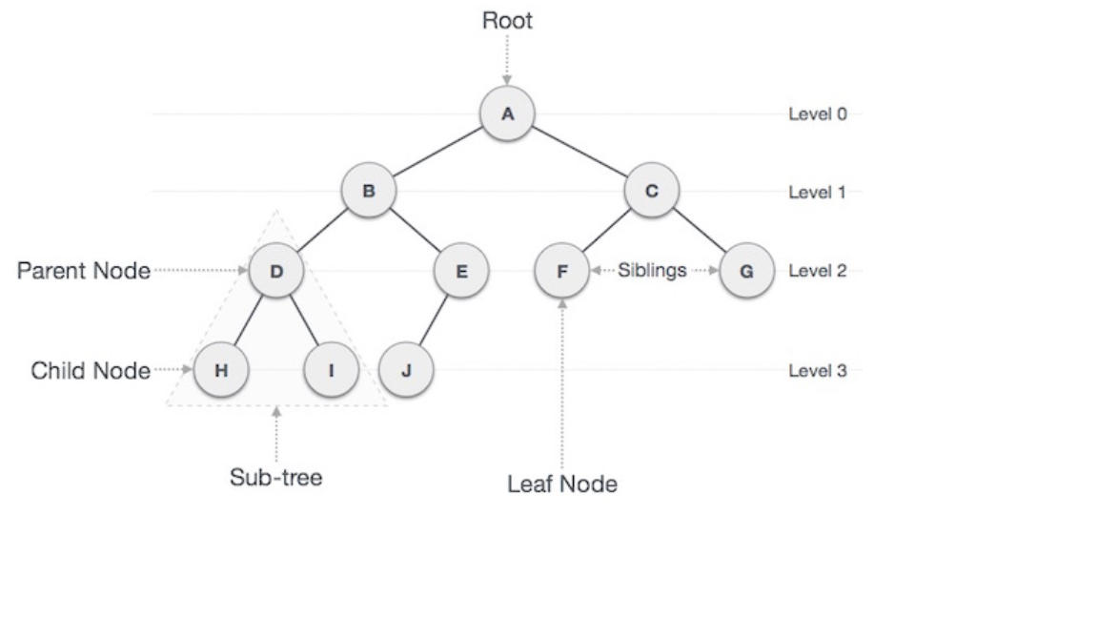
Tree

Slide 6
Binary Tree
A tree whose elements have at most 2 children is called a binary tree.
Since each element in a binary tree can have only 2 children, we typically name them the left and right child.

Slide 7
Properties of Binary Tree
Maximum number of nodes in a binary tree at level “i” is 2^{i}.
Maximum number of nodes in a binary tree with height “h” is 2^{h} -1.

Slide 8
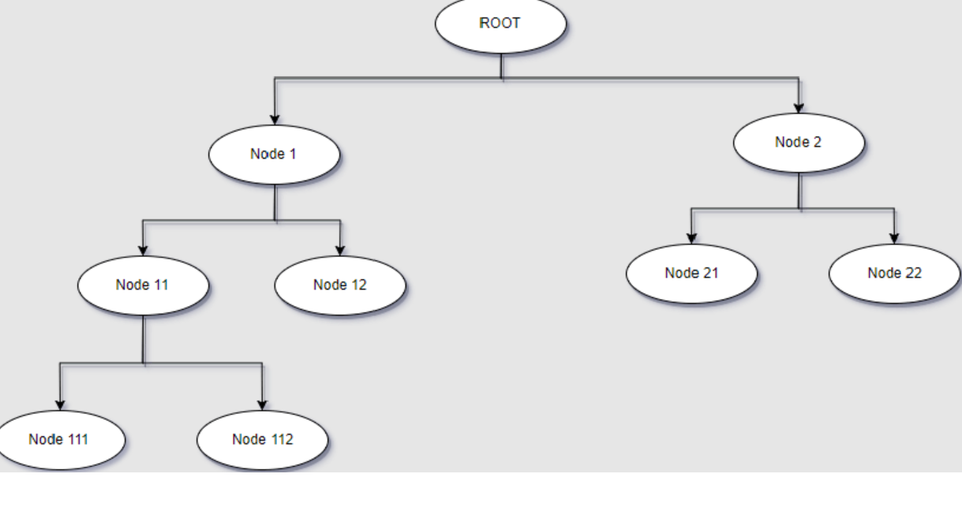
Binary Tree

Slide 9
Binary Tree Representation
A binary tree is represented by a pointer to the topmost node in tree. If the tree is empty, then value of root is NULL.
A binary tree node contains following parts. 1. Data 2. Pointer to left child 3. Pointer to right child

Slide 10
Node Class of Binary Tree
class Node
{
int key;
Node left, right;
public Node(int item)
{
key = item;
left = right = null;
}
}

Slide 11
Insertion in a Binary Tree
For inserting a node in a binary tree you will have to check the following conditions:
If a node in the binary tree does not have its left child, then insert the given node(the one that we have to insert) as its left child.
If a node in the binary tree does not have its right child then insert the given node as its right child.
If the above-given conditions do not apply then search for the node which does not have a child at all and insert the given node there.
We can use a queue for implementation of this algorithm, as it is easy to store and retrieve the nodes of the binary tree that way because queue follows the FIFO rule. Also, most of the tree algorithms are implemented using a queue.

Slide 12
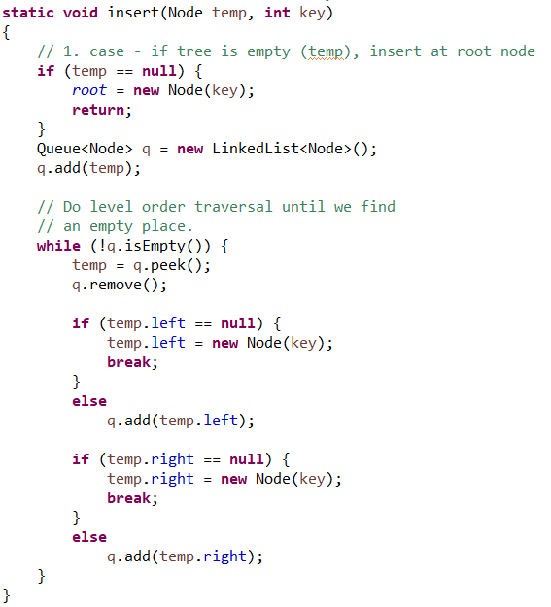
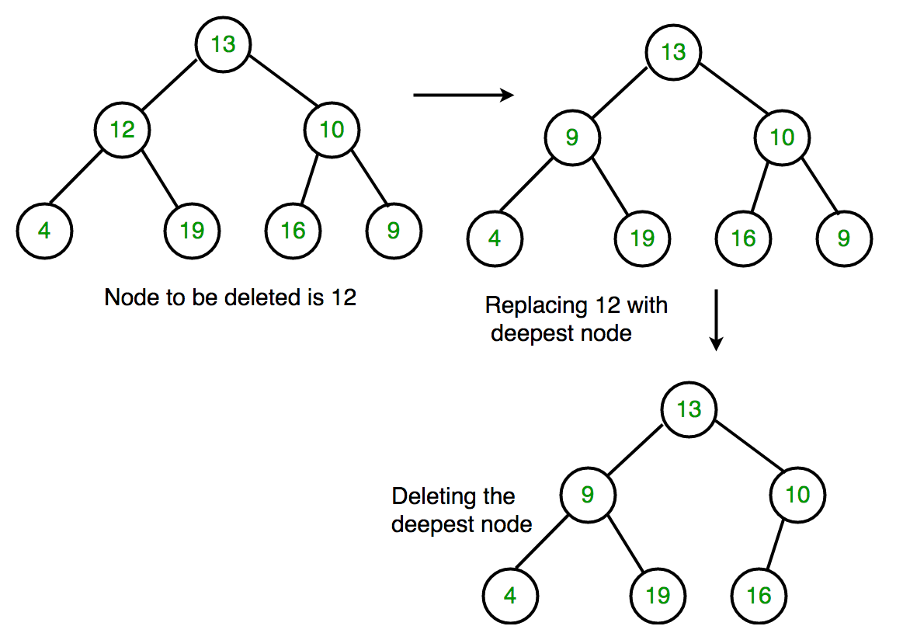
Implementation

Slide 13
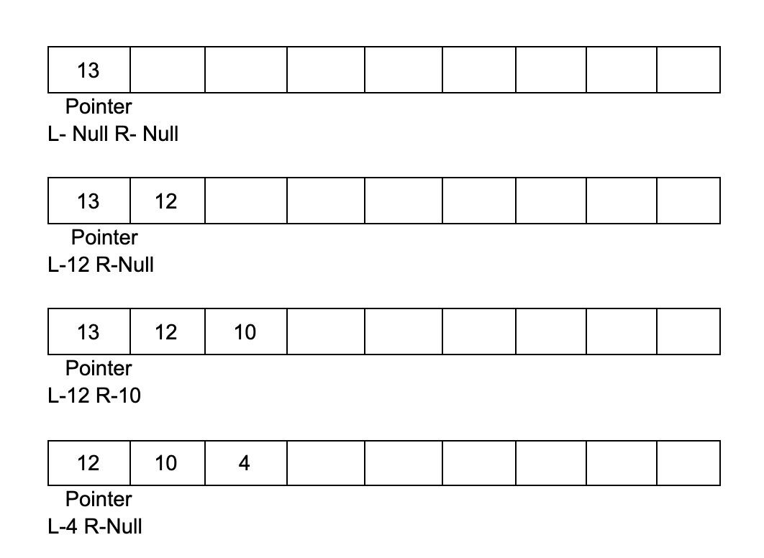
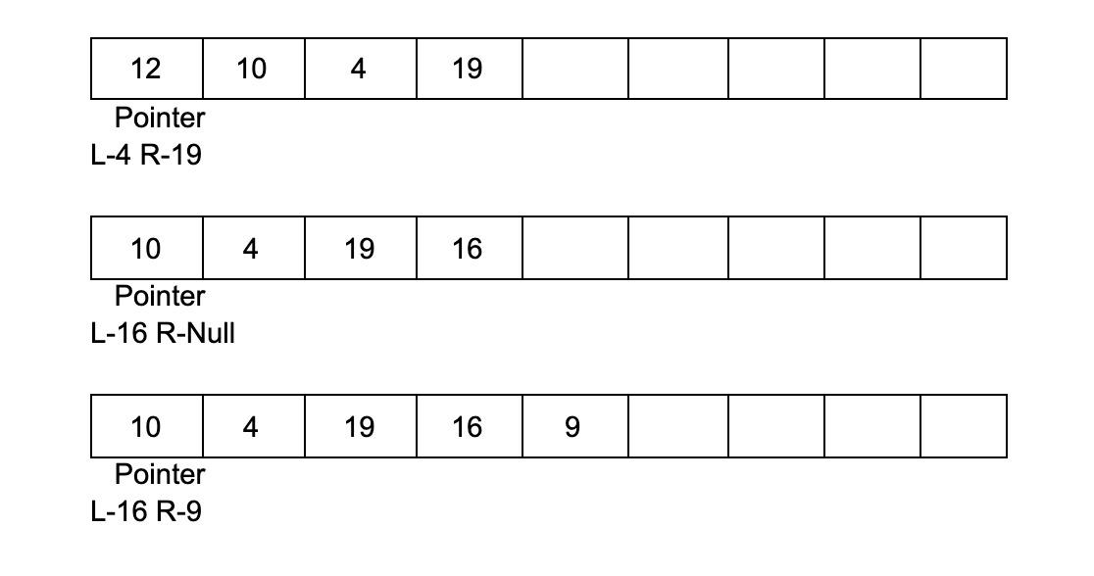
How It Works

Slide 14
Deleting a node in a Binary Tree
Algorithm 1. Starting at the root, find the deepest and rightmost node in binary tree and node which we want to delete. 2. Replace the deepest rightmost node’s data with the node to be deleted. 3. Then delete the deepest rightmost node.

Slide 15
Deletion in a Binary Tree

Slide 16
Binary Search Tree(BST)
Binary Search Tree is a node-based binary tree data structure which has the following properties:
The left subtree of a node contains only nodes with keys lesser than the node’s key.
The right subtree of a node contains only nodes with keys greater than the node’s key.
The left and right subtree each must also be a binary search tree. There must be no duplicate nodes.
{30,20,40,70,60,80}
BST Visualisation : https://www.cs.usfca.edu/~galles/visualization/BST.html

Slide 17
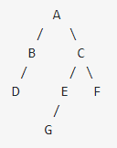
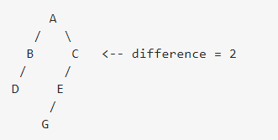
Height Balanced Tree
The constraint is generally applied recursively to every subtree. That is, the tree is only balanced if:
The left and right subtrees' heights differ by at most one, AND
The left subtree is balanced, AND
The right subtree is balanced

Slide 18
Red Black Tree
A red-black tree is a kind of self-balancing binary search tree where each node has an extra bit, and that bit is often interpreted as the colour (red or black).
Roughly Balanced
These colours are used to ensure that the tree remains balanced during insertions and deletions. Although the balance of the tree is not perfect, it is good enough to reduce the searching time and maintain it around O(log n) time, where n is the total number of elements in the tree
Notes:
RBT
Red-Black Tree | Set 2 (Insert) - GeeksforGeeks

Slide 19
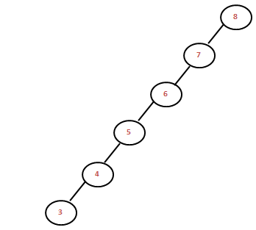
Why Red Black Tree?
Most of the BST operations (e.g., search, max, min, insert, delete.. etc) take O(h) time where h is the height of the BST.
The cost of these operations may become O(n) for a skewed Binary tree. If we make sure that the height of the tree remains O(log n) after every insertion and deletion, then we can guarantee an upper bound of O(log n) for all these operations. The height of a Red-Black tree is always O(log n) where n is the number of nodes in the tree.
Red Black Tree : For frequent insertions & deletions
AVL Tree : For frequent searching
Notes:
Why we need self balancing bst

Slide 20
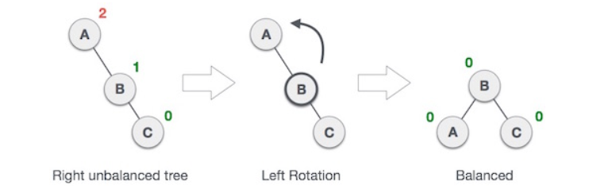
Basic Rotations
RR Imbalance: Left Rotation
{A,B,C}
Rotations Visualisation : https://www.cs.usfca.edu/~galles/visualization/AVLtree.html

Slide 21
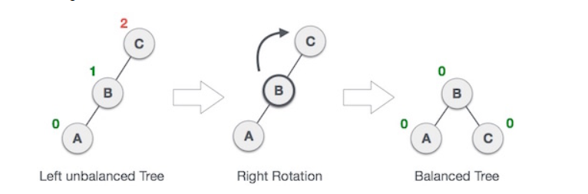
Basic Rotations II
LL Imbalance: Right Rotation
{C,B,A}

Slide 22
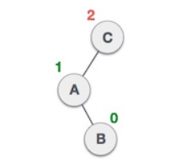
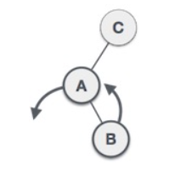
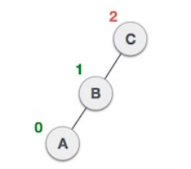
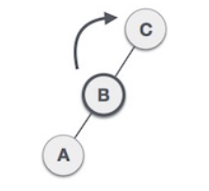
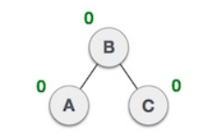
Basic Rotations III
Left Right : LR Rotation
{C,A,B}

Slide 23
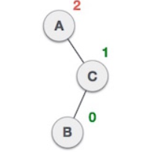
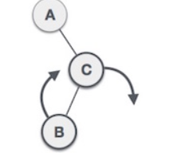
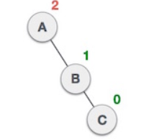
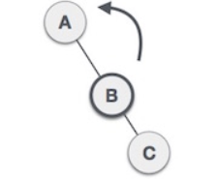
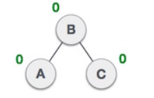
Basic Rotations IV
Right Left : RL Rotation
{A,C,B}

Slide 24
Rules of RBT
At every state it is a BST
Every node is red or black
Root Node is always black
Every path from root to leaf has same number of black nodes(Black Node Ppty)
Adjacent Red values are not allowed
NULL nodes are considered Black

Slide 25
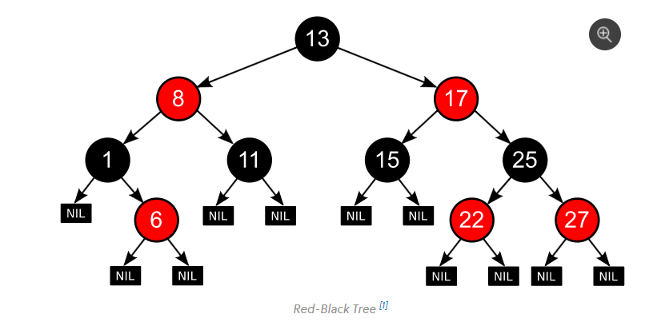
Example

Slide 26
RBT Insertion Steps
Perform standard BST insertion and make the colour of newly inserted nodes as RED.
If x is the root, change the colour of x as BLACK (Black height of complete tree increases by 1).
Do the following if the color of x’s parent is not BLACK and x is not the root. a) If x’s uncle is RED (Grandparent must have been black from property 4) (i) Change the colour of parent and uncle as BLACK. (ii) Colour of a grandparent as RED if it is not root node.If its is then return. (iii) Change x = x’s grandparent, repeat steps 2 and 3 for new x.
Notes:
1.bst
2.empty
3.black par
4.red par

Slide 27
RBT Insertion Steps Cont..
b) If x’s uncle is BLACK or NULL, then there can be four configurations for x, x’s parent (p) and x’s grandparent (g) (This is similar to Rotations that we saw before) (i) Left Left Case (p is left child of g and x is left child of p) (ii) Left Right Case (p is left child of g and x is the right child of p) (iii) Right Right Case (Mirror of case i) (iv) Right Left Case (Mirror of case ii)
Then recolour

Slide 28
Insertion Example
{1,4,6,3,5,7,8,2,9}
Red Black Tree Visulaization:
https://www.cs.usfca.edu/~galles/visualization/RedBlack.html

Slide 29
Thank You

